Slide 1
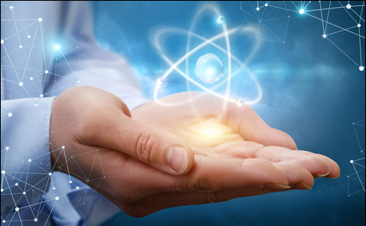
Integrated Zero Emission (INZEM) Energy System

Slide 2
Climate Change Mitigation
Summary
100x more energy
Energy in the “waste”
• Recycle / eliminate our radioactive nuclear fuel “waste”
Technology
• Replace all fossil energy in Canada for more than 500 years
Finances
• Avoid CO₂ emissions equiv. to 30% atm. content (Canada)
Take-home message:
YES WE CAN

Slide 3
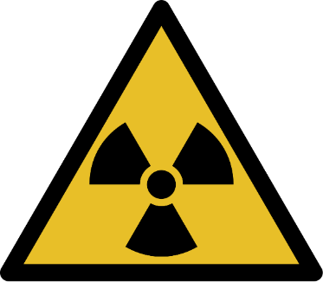
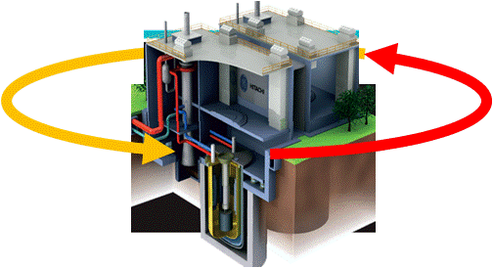
Climate Change Mitigation
Energy in
Technology
Exists
Nuclear Waste
used CANDU fuel “waste”
100,000 tonnes
sugar
gold
Value of ½ inch cube
99% uranium
recycle /
avoid
950 billion tonnes CO₂
5 billion such cube volumes of used CANDU fuel “waste”
$ 0.02
$ 2,168*
>$ 20,000 CO₂-free electricity
eliminate
(2 cents)
( )
~30% of CO₂
>500 years
using
Fast-Neutron Reactors
decades
in atmosphere
$ 105,000,000,000,000
FNR
$ 105 Trillion
Heat
Electricity
since 1950
May 7 2018 15:42, CAD 54.74 /g
https://goldprice.org/gold-price-per-gram.html
tested walk-away safe, 1986

Slide 4
Climate Change Mitigation
Energy in
Technology
Exists
Nuclear Waste
100,000 tonnes
Desalination
Kazakhstan (Caspian Sea)
Cape Town next ?
Process Steam
avoid
Switzerland
District Heating
950 billion tonnes CO₂
( )
Hungary
~30% of CO₂
Greenhouses
>500 years
in atmosphere
$ 105,000,000,000,000
Canada
$ 25-135 Trillion
FNR
$ 105 Trillion
Heat
Heat
Electricity
Fast-Neutron Reactors
since 1950
tested walk-away safe, 1986

Slide 5
Climate Change Mitigation
Energy in
Technology
Exists
Nuclear Waste
100,000 tonnes
Desalination
Kazakhstan (Caspian Sea)
Cape Town next ?
Process Steam
Finances ?
Switzerland
District Heating
Greenhouses
Hungary
Canada
$ 25-135 Trillion
FNR
$ 105 Trillion
Heat
Heat
Electricity
Fast-Neutron Reactors
since 1950
tested walk-away safe, 1986

Slide 6
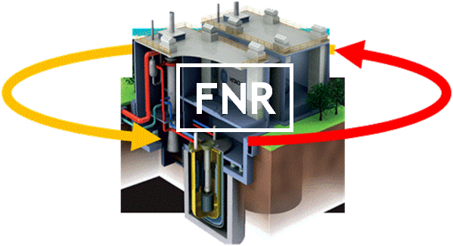
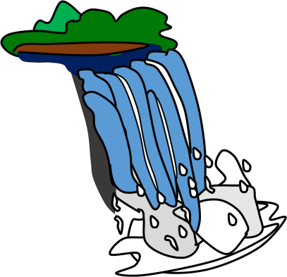
Climate Change Mitigation
Energy in
Technology
Exists
Start-up Funds
Exist
Nuclear Waste
100,000 tonnes
1.
$10 billion for nuclear fuel waste management
(Ontario Nuclear Fuel Agreement Trust)
2.
Electricity price reform: fixed cost for infrastructure; low cost for energy
3.
Investment to grow: developers, infrastr./commercial banks, pension funds….
Fast-Neutron Reactors
since 1950
tested walk-away safe, 1986

Slide 7
Climate Change Mitigation
Summary
• Recycle / eliminate our radioactive nuclear fuel “waste”
• Replace all fossil energy in Canada for more than 500 years
• Avoid CO₂ emissions equiv. to 30% atm. content (Canada)
Take-home message:
YES WE CAN

Slide 9
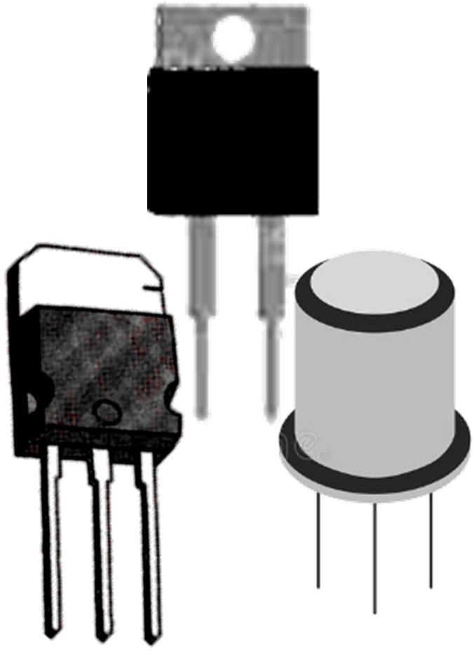
Climate Change Mitigation
Value of
Technology
Exists
Nuclear Waste
100,000 tonnes
used CANDU fuel “waste”
Is there a
Residue ?
$ 25-135 Trillion
FNR
$ 105 Trillion
Heat
Heat
Electricity
“ashes”
rare earth
platinum-group
fission products
elements
precious metals
Fast-Neutron Reactors
since 1950
$ 3 million / tonne
tested walk-away safe, 1986

